Slide 1

GENE INTERACTION

Slide 2

The study of the inheritance of the seven characters in peas laid foundation to the formulation and understanding of the basic laws of inheritance. These laws and all other related assumptions make up the Mendelism.

Slide 3
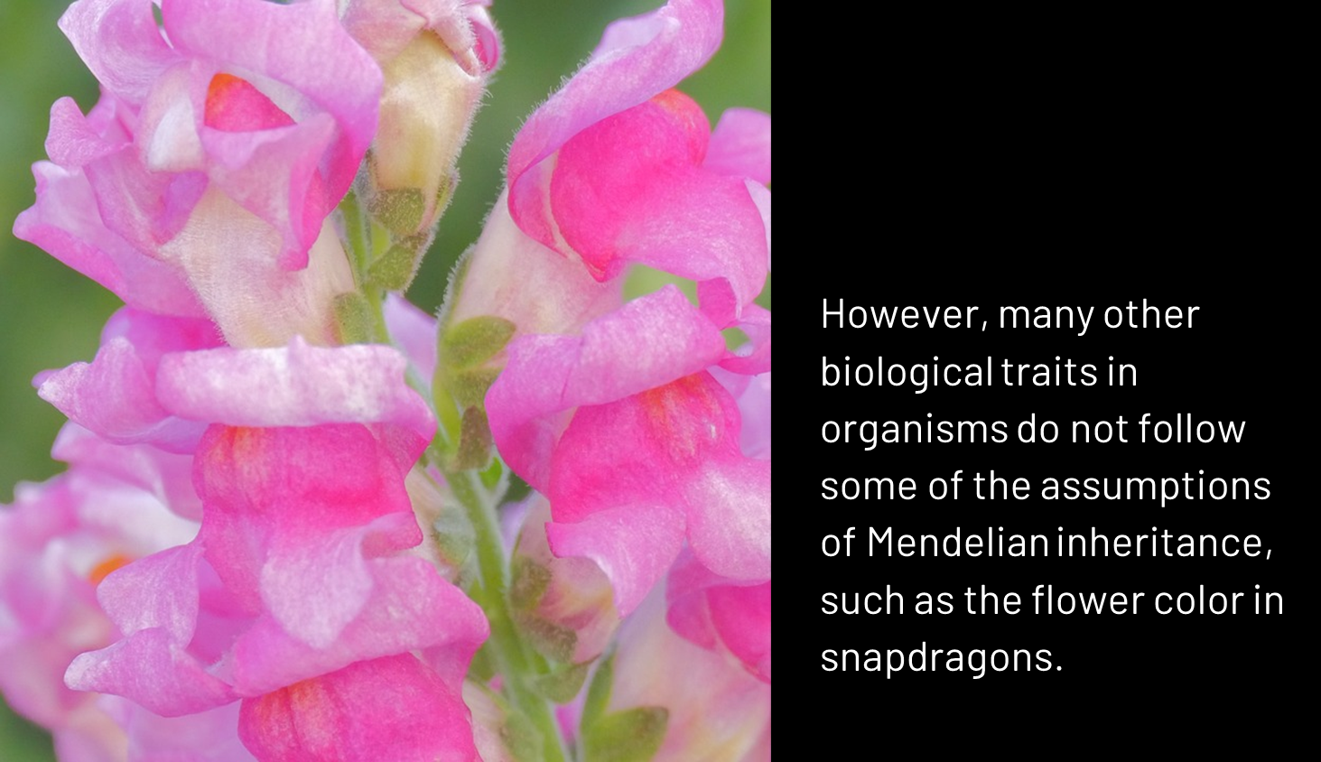
However, many other biological traits in organisms do not follow some of the assumptions of Mendelian inheritance, such as the flower color in snapdragons

Slide 4
How are traits that do not follow Mendel’s assumptions inherited?

Slide 5
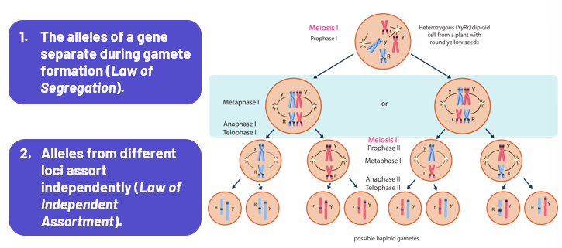

Slide 6
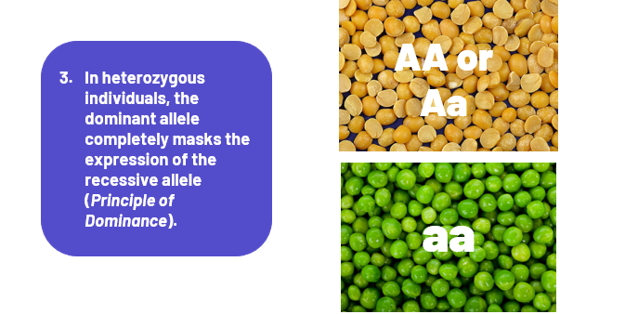

Slide 7
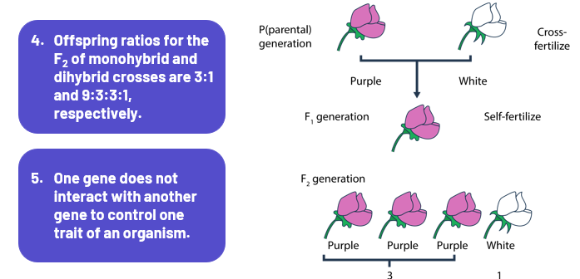

Slide 8
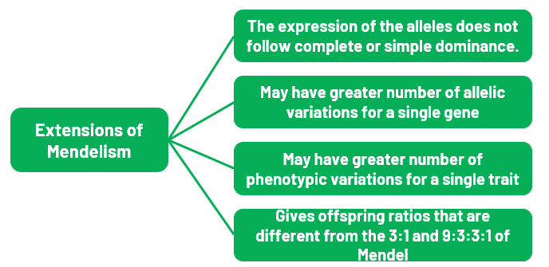

Slide 9
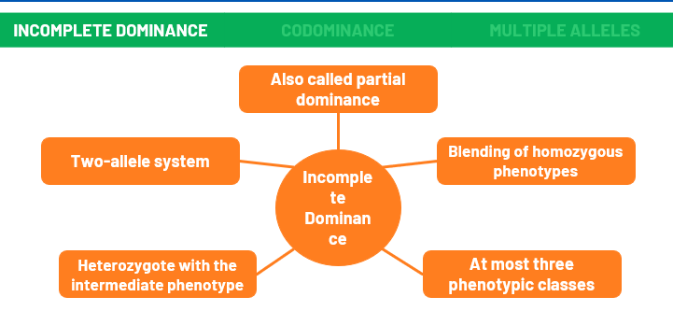

Slide 10


Slide 11
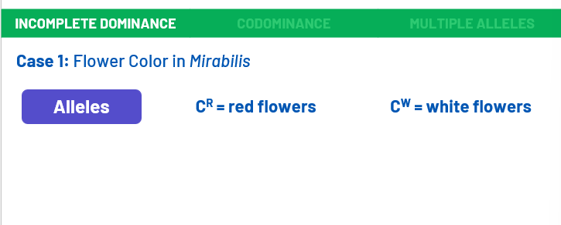

Slide 12
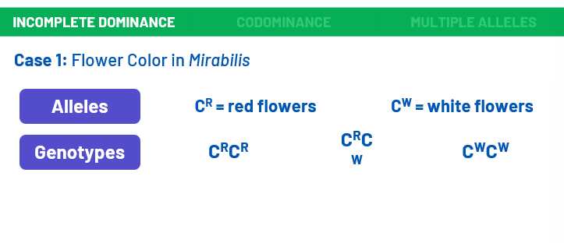

Slide 13
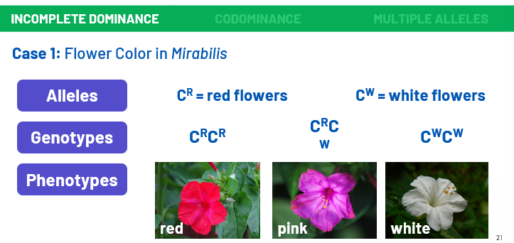

Slide 14


Slide 15
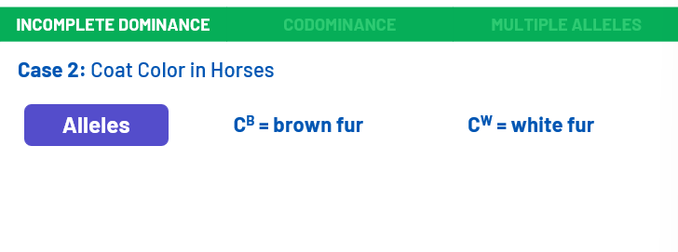

Slide 16
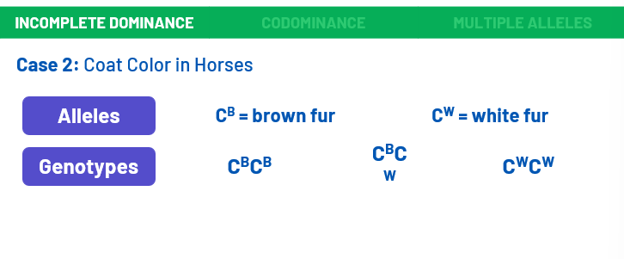

Slide 17
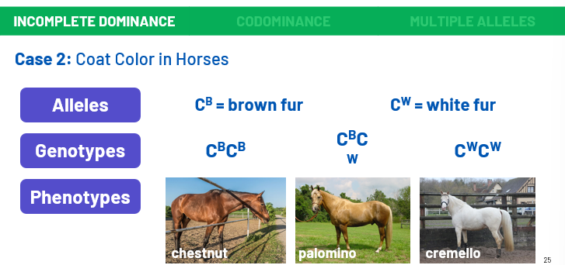

Slide 18
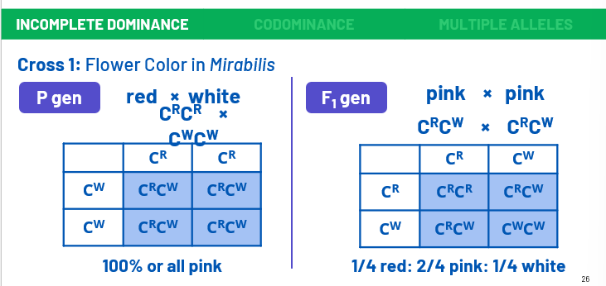

Slide 19
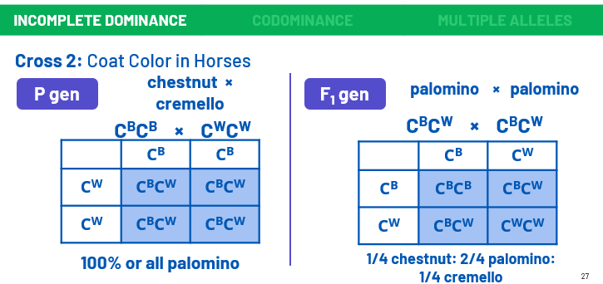

Slide 20


Slide 21
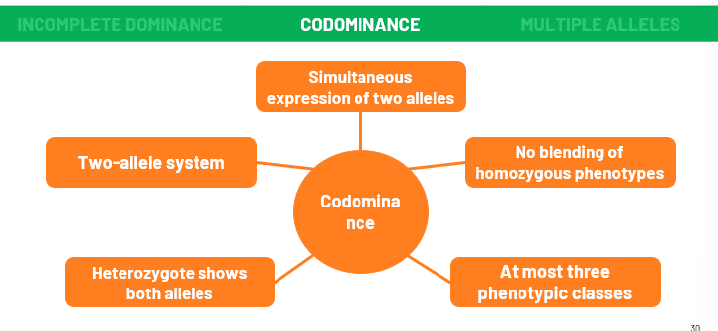

Slide 22


Slide 23
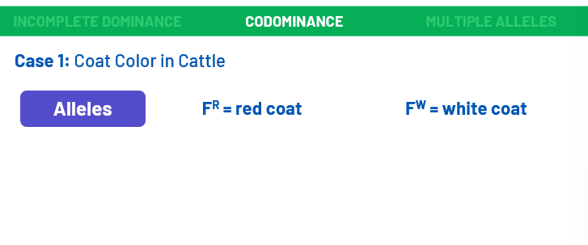

Slide 24
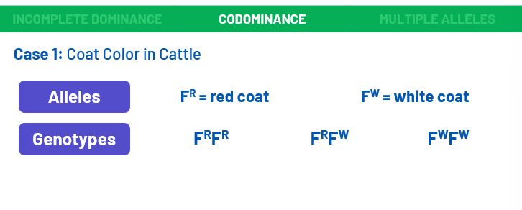

Slide 25
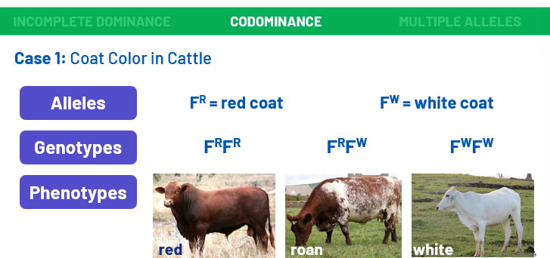

Slide 26


Slide 27
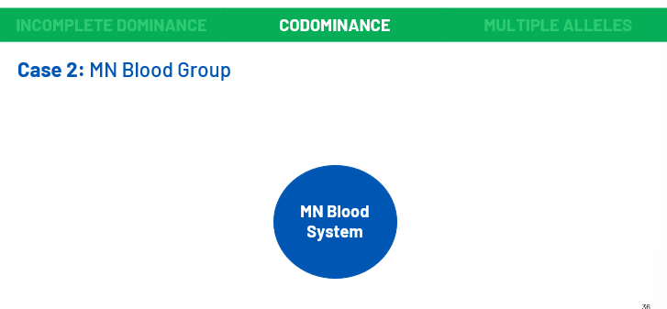

Slide 28
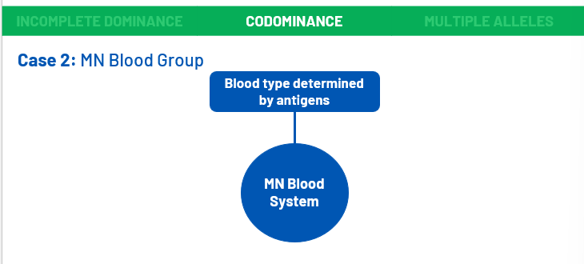

Slide 29
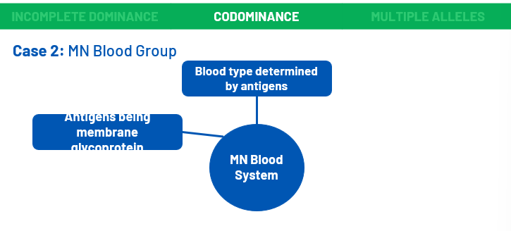

Slide 30
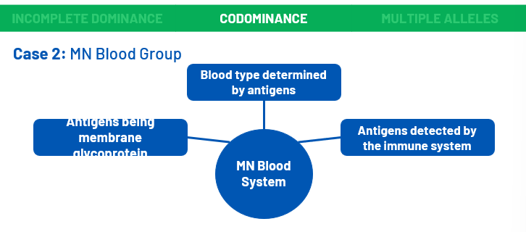

Slide 31
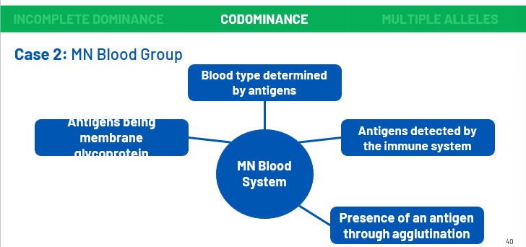

Slide 32
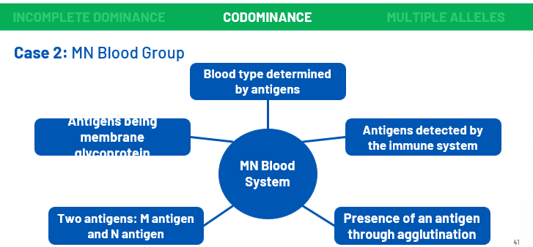

Slide 33
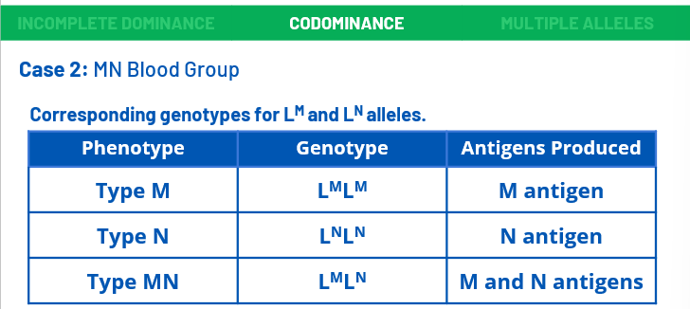

Slide 34
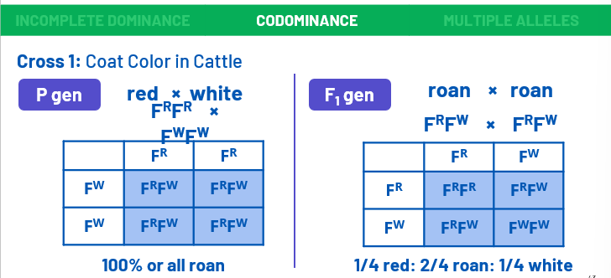

Slide 35
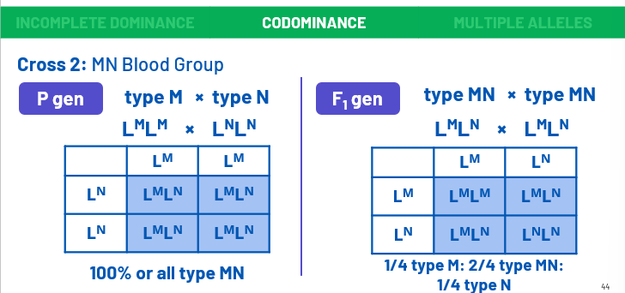

Slide 36


Slide 37
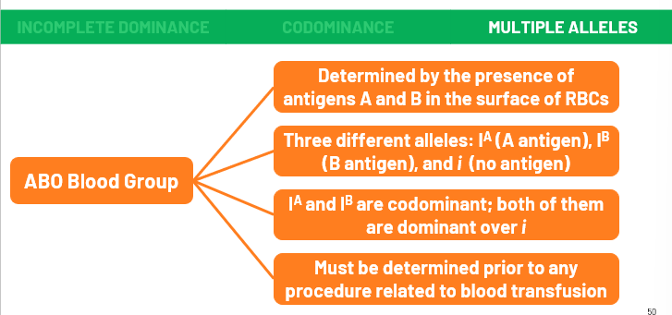

Slide 38
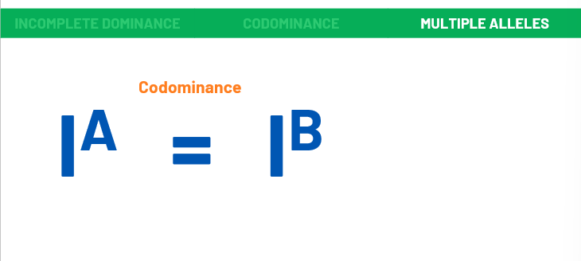

Slide 39
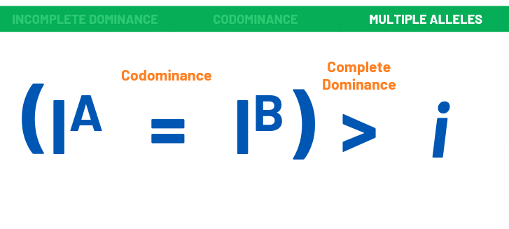

Slide 40
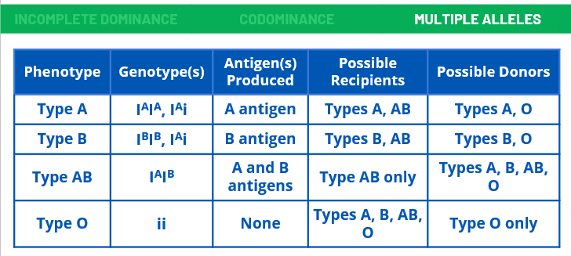

Slide 41
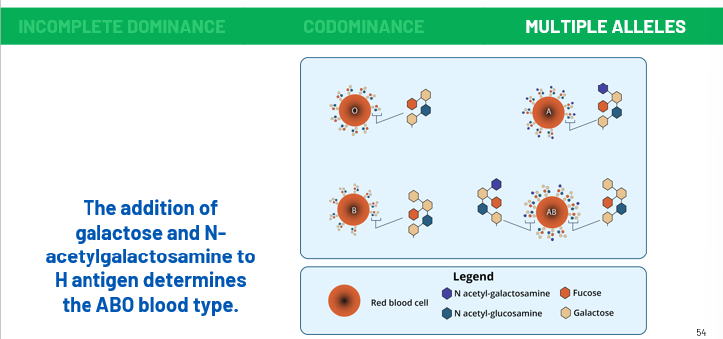

Slide 42
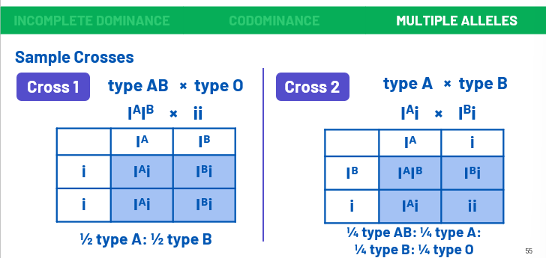

Slide 43
GENETIC INTERACTION

Slide 44
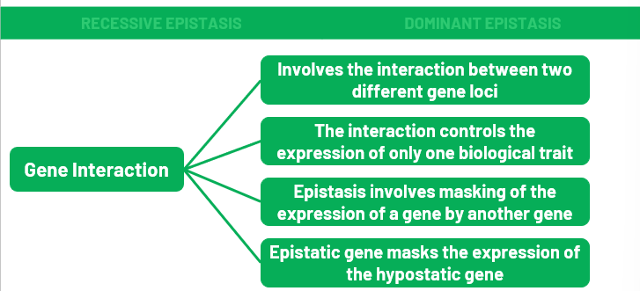

Slide 45
How do genes from two different loci interact to control the expression of one phenotypic trait?

Slide 46
The relationship between epistatic and hypostatic genes is like the relationship between dominant and recessive alleles of a locus.
In complete dominance, the dominant allele completely masks the expression of the recessive allele in a heterozygous individual. In epistatic interaction, two loci are already involved. It may be the recessive allele a that masks the expression of the alleles B and b. In this case, allele a is epistatic over hypostatic alleles B and b.

Slide 47
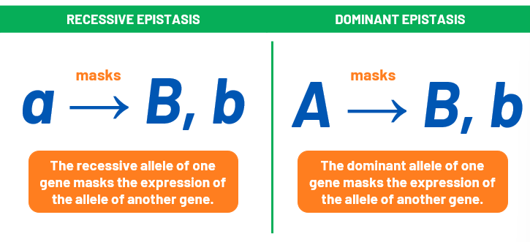

Slide 48


Slide 49


Slide 50
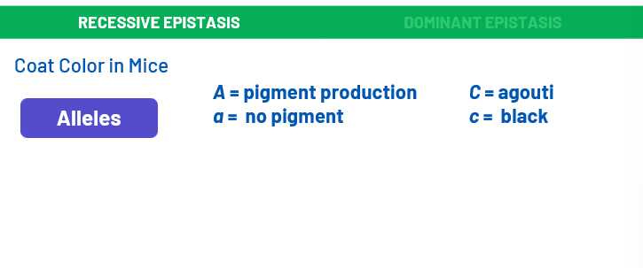

Slide 51
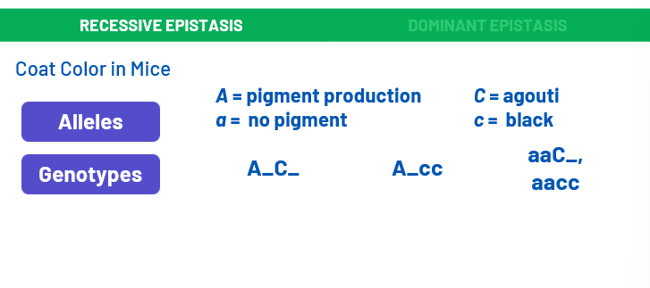

Slide 52
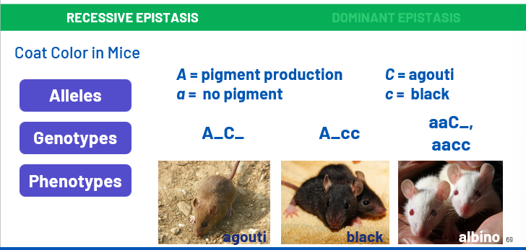

Slide 53
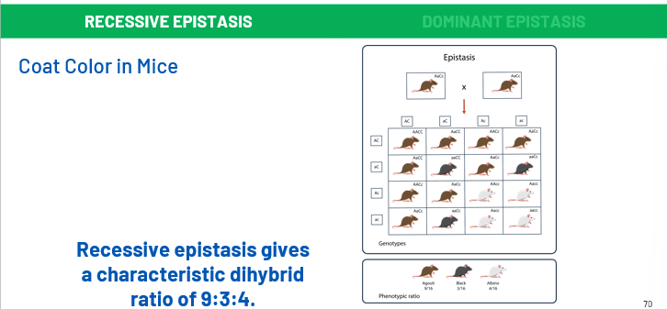

Slide 54


Slide 55
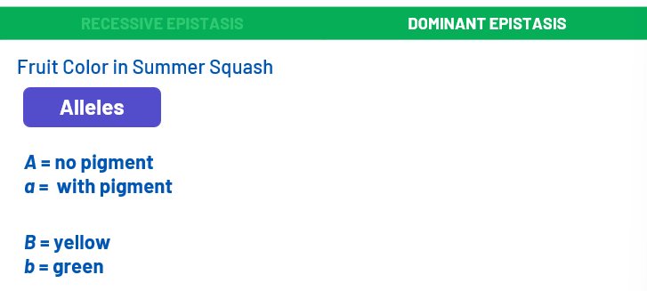

Slide 56
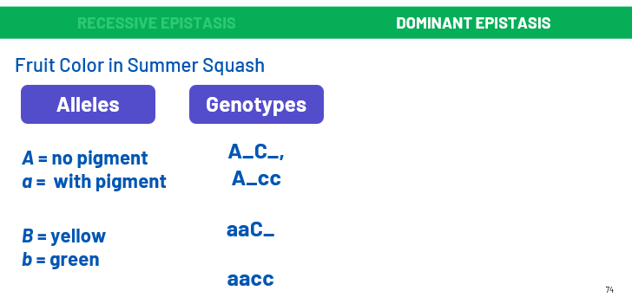

Slide 57
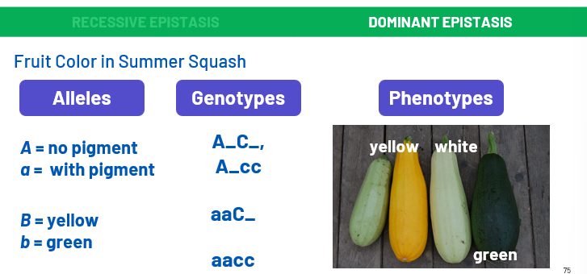

Slide 58
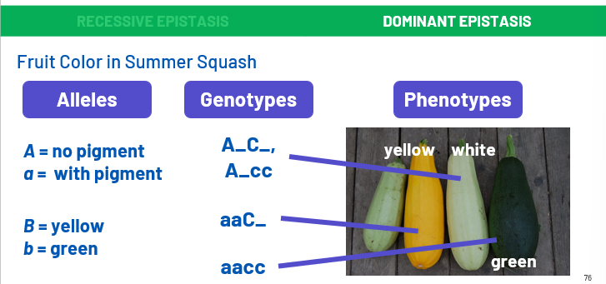

Slide 59
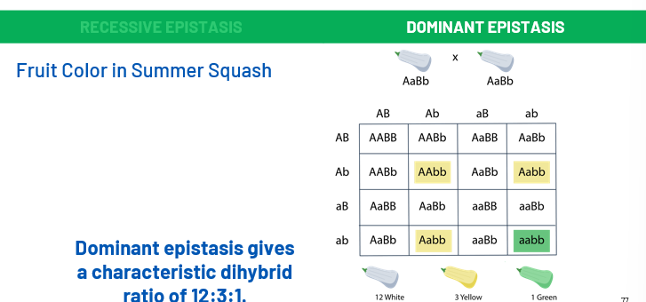

Slide 60
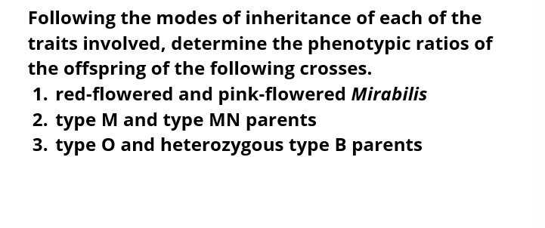

Slide 61
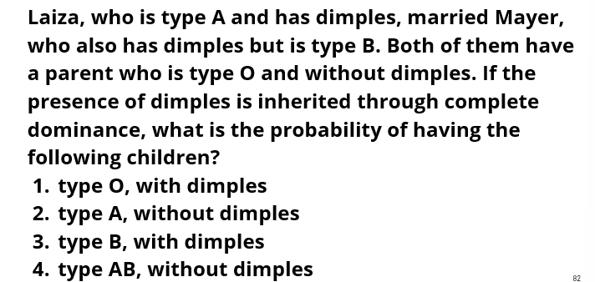

Slide 62
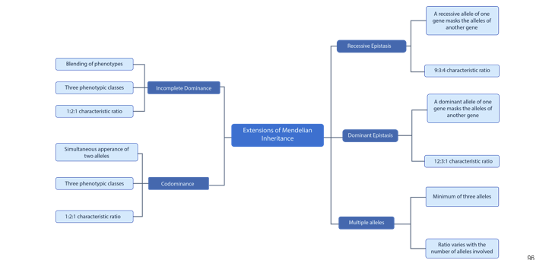

Slide 63
Brooker, J. Concepts of Genetics (1st ed.). New York, USA: McGraw-Hill Companies Inc., 2012.
Klug, W.S, and Cummings, M.R. Concepts of genetics (6th ed). Upper Saddle River, N.J: Prentice-Hall. 2003.
Pierce, B. Genetics: a conceptual approach (8th ed). New York: W.H. Freeman. 2012.
Reece J., Taylor M., Simon E., and Dickey J. Campbell Biology: Concepts and Connections (7th ed.). Boston: Benjamin Cummings/Pearson. 2011.
Snustad, D.P., and Simmons, M.J. Principles of Genetics (6th ed.). Hoboken, NJ: Wiley. 2012.

